Slide 1
C# Fundamentals
Chapter - 2

Slide 2
Building the first console application

Slide 3
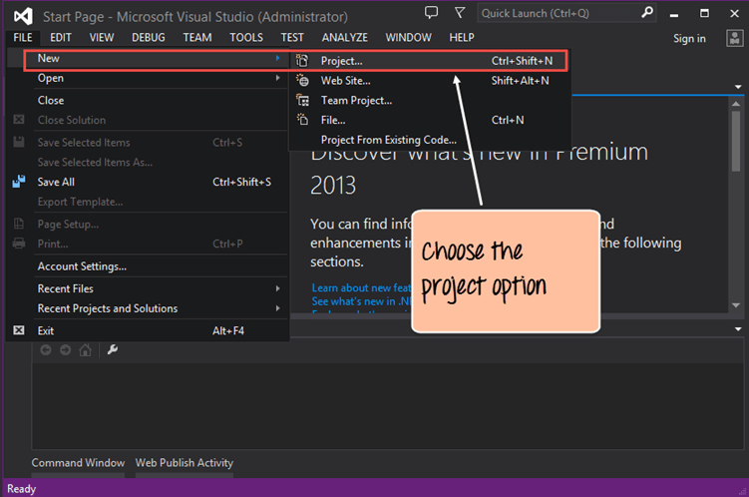
A console application is an application that can be run in the command prompt in Windows.
Step 1) The first step involves the creation of a new project in Visual Studio. For that, once the Visual Studio is launched, you need to choose the menu option New->Project.

Slide 4
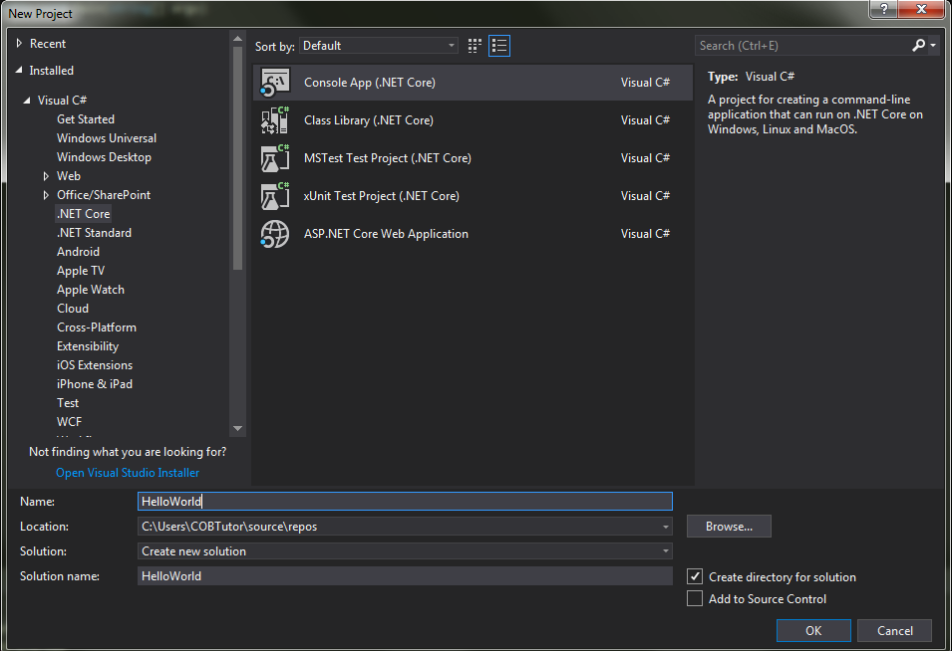
Step 2) The next step is to choose the project type as a Console application. Here, we also need to mention the name and location of our project

Slide 5
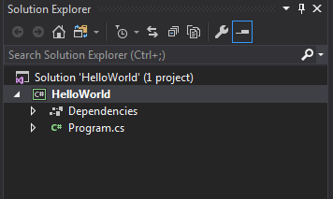
A project called ‘Hello World’ will be created in Visual Studio. This project will contain all the necessary artifacts required to run the Console application.
The Main program called Program.cs is default code file which is created when a new application is created in Visual Studio. This code will contain the necessary code for our console application.

Slide 6
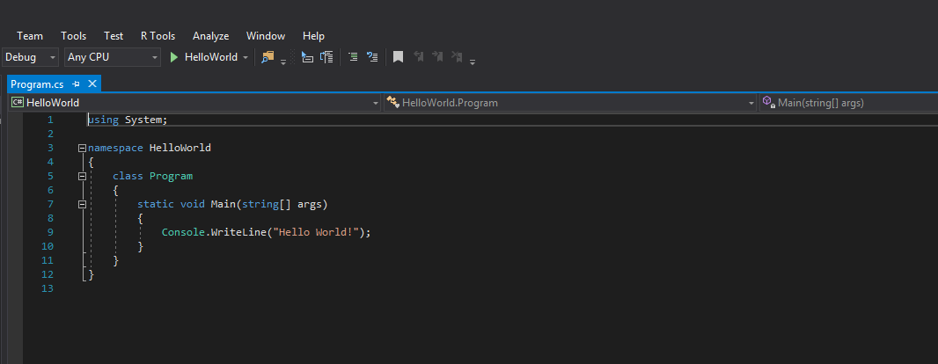
Step 3) The line of code required to print “Hello world” is automatically included....
All the code will be in the Program.cs file.

Slide 7
Code Explanation
The first lines of code are default lines entered by Visual Studio. The 'using' statement is used to import existing .Net modules in our console application. These modules are required for any .Net application to run properly. They contain the bare minimum code to make a code work on a Windows machine.
Every application belongs to a class. C# is an object-oriented language, and hence, all code needs to be defined in a self-sustaining module called a 'Class.' In turn, every class belongs to a namespace. A namespace is just a logical grouping of classes.

Slide 8
Code Explanation
The Main function is a special function which is automatically called when a console application runs. Here you need to ensure to enter the code required to display the required string in the console application.
The Console class is available in .Net which allows one to work with console applications. Here we are using an inbuilt method called 'WriteLine' to write the string “Hello World" on the console.
We then use the Console.ReadKey() method to read any key from the console. By entering this line of code, the program will wait and not exit immediately. The program will wait for the user to enter any key before finally exiting. If you don't include this statement in code, the program will exit as soon as it is run.

Slide 9
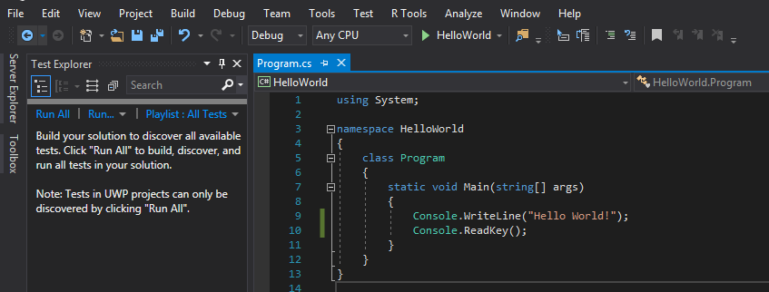
Step 4) Run your .Net program. To run any program, you need to click the green button with the the projectname.

Slide 10
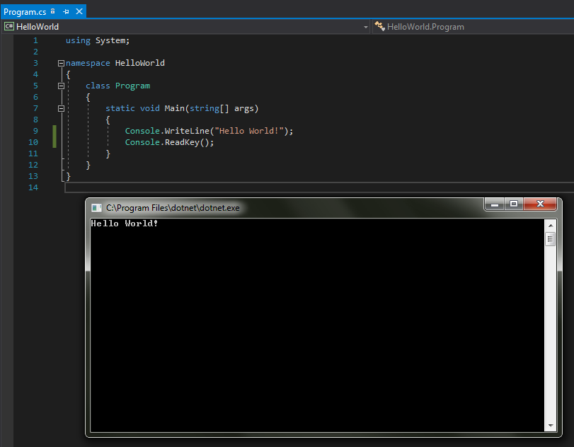
output

Slide 11
datatypes

Slide 12
Kinds of datatypes
There are two kinds of datatypes in C#:
value types and
reference types.
Variables of value types directly contain their data whereas variables of reference types store references to their data, the latter being known as objects.
With reference types, it is possible for two variables to reference the same object and thus possible for operations on one variable to affect the object referenced by the other variable.
With value types, the variables each have their own copy of the data, and it is not possible for operations on one to affect the other

Slide 13
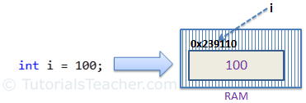
Value Type
A data type is a value type if it holds a data value within its own memory space. It means variables of these data types directly contain their values.
For example, consider an integer variable declaration : int i = 100;
The system stores 100 in the memory space allocated for the variable 'i'. The following image illustrates how 100 is stored at some hypothetical location in the memory (0x239110) for 'i':

Slide 14
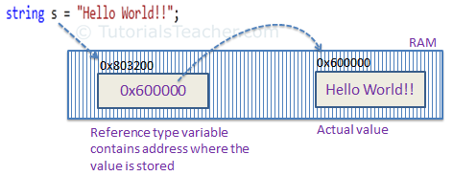
Reference type:
Unlike value types, a reference type doesn't store its value directly. Instead, it stores the address where the value is being stored. In other words, a reference type contains a pointer to another memory location that holds the data.
For example, consider following string variable:
string s = "Hello World!!";
The following image shows how the system allocates the memory for the above string variable.

Slide 15
C# datatypes
C#’s value types are further divided into
simple types,
enum types,
struct types, and
nullable value types.
C#’s reference types are further divided into
class types,
interface types,
array types, and
delegate types.

Slide 17
Notes:
C# delegates are similar to pointers to functions, in C or C++. A delegate is a reference type variable that holds the reference to a method.

Slide 18
C# datatypes
The eight integral types provide support for 8-bit, 16-bit, 32-bit, and 64-bit values in signed or unsigned form.
The two floating-point types, float and double, are represented using the 32-bit single-precision and 64-bit double-precision formats, respectively.
The decimal type is a 128-bit data type suitable for financial and monetary calculations.
C#’s bool type is used to represent Boolean values—values that are either true or false.
Character and string processing in C# uses Unicode encoding.

Slide 20
C# Data Types-Alias vs .Net Type
In the above table of data types, first column is for data type alias and second column is actual .Net type name.
For example, int is an alias (or short name) for Int32. Int32 is a structure defined in System namespace. The same way, string represents the String class.

Slide 21
C# Data Types-Alias vs .Net Type
The C# type keywords and their aliases are interchangeable.
For example, you can declare an integer variable by using either of the following declarations:
int x = 123;
System.Int32 x = 123;

Slide 22
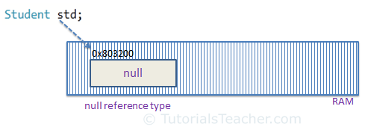
null value
Reference types have null value by default, when they are not initialized.
For example, a string variable (or any other variable of reference type datatype) without a value assigned to it. In this case, it has a null value, meaning it doesn't point to any other memory location, because it has no value yet.

Slide 23
null value
A value type variable cannot be null because it holds a value not a memory address.
However, value type variables must be assigned some value before use. The compiler will give an error if you try to use a local value type variable without assigning a value to it.

Slide 24
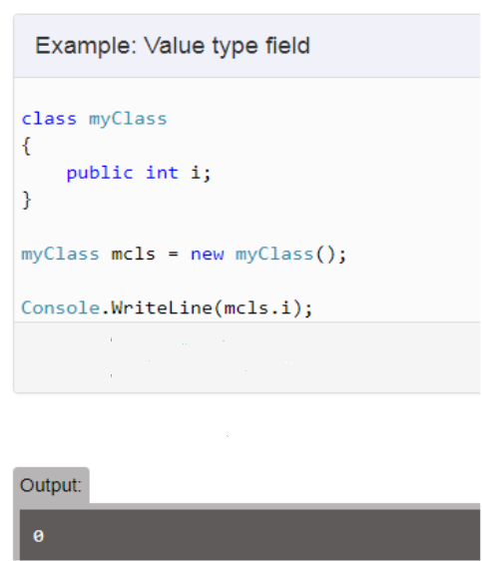
null value
However, value type field in a class can be declared without initialization (field not a local variable in the function) .
It will have a default value if not assigned any value, e.g., int will have 0, boolean will have false and so on.

Slide 25
Type conversions

Slide 26
Type conversion
Type conversion is converting one type of data to another type. It is also known as Type Casting. In C#, type casting has two forms −
Implicit type conversion − These conversions are performed by C# in a type-safe manner. For example are, conversions from smaller to larger integral types and conversions from derived classes to base classes.
Explicit type conversion − These conversions are done explicitly by users using the pre-defined functions. Explicit conversions require a cast operator.

Slide 27
Type conversion
For instance, the conversion from type int to type long is implicit, so expressions of type int can implicitly be treated as type long.
The opposite conversion, from type long to type int, is explicit and so an explicit cast is required.
int a = 123;
long b = a; // implicit conversion from int to long
int c = (int) b; // explicit conversion from long to int

Slide 29
Type conversion
Microsoft .NET provides three ways of type conversion:
1. Parsing
2. Convert Class
3. Explicit Cast Operator ()

Slide 30
Parsing is used to convert string type data to primitive value type.
For this we use parse methods with value types.

Slide 31
Convert Class
Used to convert from One primitive type to another primitive type.
This class contains different static methods like ToInt32(), ToInt16(), ToString(), ToDateTime() etc used in type conversion.

Slide 32
Explicit Cast Operator ()
In general this operator is used with primitive types to up level or down level casting.

Slide 34
keywords

Slide 35
C# Keywords
C# contains reserved words, that have special meaning for the compiler. These reserved words are called "keywords".
Keywords cannot be used as a name (identifier) of a variable, class, interface, etc.
However, they can be used as an identifier with the prefix '@’.
For example, @if is a valid identifier, but if is not because if is a keyword.

Slide 36
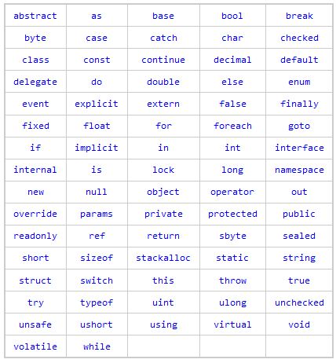

Slide 37
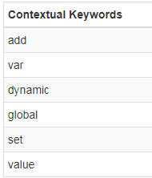
Contextual Keywords
Contextual keywords are considered as keywords, only if used in certain contexts. They are not reserved and so can be used as names or identifiers.

Slide 38
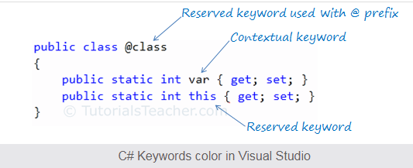
Contextual keywords
Contextual keywords are not converted into blue color (default color for keywords in visual studio) when used as an identifier in Visual Studio. For example, var in the below figure is not in blue color whereas color of this is blue color. So var is a contextual keyword.

Slide 39
operators

Slide 40
Operators
An operator is a program element that is applied to one or more operands in an expression or statement.
Operators that take one operand, such as the increment operator (++) or new, are referred to as unary operators.
Operators that take two operands, such as arithmetic operators (+,-,*,/), are referred to as binary operators.
One operator, the conditional operator (?:), takes three operands and is the sole ternary operator in C#.

Slide 42
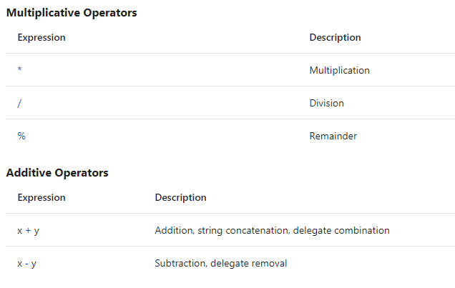

Slide 46
Associativity
When two or more operators that have the same precedence are present in an expression, they are evaluated based on associativity. Left-associative operators are evaluated in order from left to right. For example, x * y / z is evaluated as (x * y) / z.
Right-associative operators are evaluated in order from right to left. For example, the assignment operator is right associative. If it were not, the following code would result in an error.

Slide 47
As another example the ternary operator (?:) is right associative. Most binary operators are left associative.
Whether the operators in an expression are left associative or right associative, the operands of each expression are evaluated first, from left to right. The following examples illustrate the order of evaluation of operators and operands.

Slide 48
Control structures

Slide 49
Selection statements

Slide 50
Selection Statements
A selection statement causes the program control to be transferred to a specific flow based upon whether a certain condition is true or not.
The following keywords are used in selection statements:
if
else
switch
case
default

Slide 51
If & If-else
An if statement in C# can take two forms, as the following example shows.

Slide 52
If-else
In an if-else statement, if condition evaluates to true, the then-statement runs. If condition is false, the else-statement runs. Because condition can’t be simultaneously true and false, the then-statement and the else-statement of an if-else statement can never both run. After the then-statement or the else-statement runs, control is transferred to the next statement after the if statement.
In an if statement that doesn’t include an else statement, if condition is true, the then-statement runs. If condition is false, control is transferred to the next statement after the if statement.
Both the then-statement and the else-statement can consist of a single statement or multiple statements that are enclosed in braces ({}). For a single statement, the braces are optional but recommended.

Slide 53
If-else
An if statement identifies which statement to run based on the value of a Boolean expression. In the following example, the Boolean variable condition is set to true and then checked in the if statement.

Slide 54
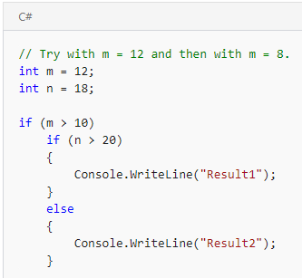
Nested If-else
The statement or statements in the then-statement and the else-statement can be of any kind, including another if statement nested inside the original if statement. In nested if statements, each else clause belongs to the last if that doesn’t have a corresponding else.
In the following example, Result1 appears if both m > 10 and n > 20 evaluate to true. If m > 10 is true but n > 20 is false, Result2 appears.

Slide 55
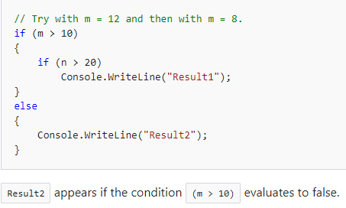
Nested If-else
If, instead, you want Result2 to appear when (m > 10) is false, you can specify that association by using braces to establish the start and end of the nested if statement, as the following example shows.

Slide 57
Switch statement
switch is a selection statement that chooses a single switch section to execute from a list of candidates based on a pattern match with the match expression.

Slide 58
Notes:
The enum keyword is used to declare an enumeration, a distinct type that consists of a set of named constants called the enumerator list.

Slide 59
Switch statement- The default case
The default case specifies the switch section to execute if the match expression does not match any other case label. If a default case is not present and the match expression does not match any other case label, program flow falls through the switch statement.
The default case can appear in any order in the switch statement. Regardless of its order in the source code, it is always evaluated last, after all case labels have been evaluated.

Slide 60
Iteration Statements

Slide 61
Iteration Statements
You can create loops by using the iteration statements. Iteration statements cause embedded statements to be executed a number of times, subject to the loop-termination criteria. These statements are executed in order, except when a jump statement is encountered.
The following keywords are used in iteration statements:
do
for
foreach in
while

Slide 62
do statement
The do statement executes a statement or a block of statements repeatedly until a specified expression evaluates to false.
The body of the loop must be enclosed in braces, {}, unless it consists of a single statement. In that case, the braces are optional.

Slide 64
While statement
The while statement executes a statement or a block of statements until a specified expression evaluates to false

Slide 65
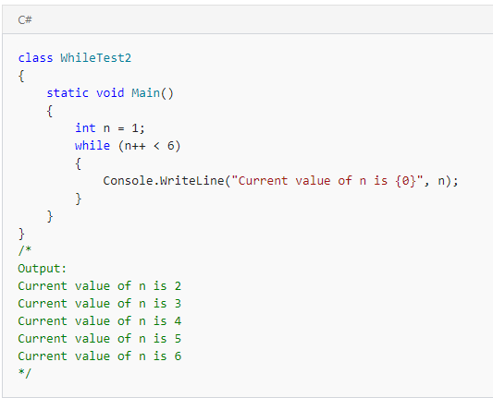

Slide 66
For loop
By using a for loop, you can run a statement or a block of statements repeatedly until a specified expression evaluates to false. This kind of loop is useful for iterating over arrays and for other applications in which you know in advance how many times you want the loop to iterate.
Every for statement defines initializer, condition, and iterator sections. These sections usually determine how many times the loop iterates.
for (initializer; condition; iterator)
body

Slide 68
The foreach, in statement
The foreach statement repeats a group of embedded statements for each element in an array or an object collection.
The foreach statement is used to iterate through the collection to get the information that you want, but can not be used to add or remove items from the source collection to avoid unpredictable side effects. If you need to add or remove items from the source collection, use a for loop.
The embedded statements continue to execute for each element in the array or collection. After the iteration has been completed for all the elements in the collection, control is transferred to the next statement following the foreach block.

Slide 70
Jump Statements

Slide 71
Jump Statements
Branching is performed using jump statements, which cause an immediate transfer of the program control. The following keywords are used in jump statements:
break
continue
goto
return
throw

Slide 72
break statement
The break statement terminates the closest enclosing loop or switch statement in which it appears.
Control is passed to the statement that follows the terminated statement, if any.
Notes:
https://docs.microsoft.com/en-us/dotnet/csharp/language-reference/keywords/break

Slide 75
continue
The continue statement passes control to the next iteration of the enclosing while, do, for, or foreach statement in which it appears.

Slide 76
goto
The goto statement transfers the program control directly to a labeled statement.
A common use of goto is to transfer control to a specific switch-case label or the default label in a switch statement.
The goto statement is also useful to get out of deeply nested loops.
Notes:
https://www.geeksforgeeks.org/c-sharp-data-types/

Slide 79
return
The return statement terminates execution of the method in which it appears and returns control to the calling method.
It can also return an optional value.
If the method is a void type, the return statement can be omitted.

Slide 80
Notes:
https://www.guru99.com/c-fundamentals-arrays-enumeration.html
http://www.tutorialsteacher.com/csharp/csharp-value-type-and-reference-type

